Slide 1
DOM

Slide 2
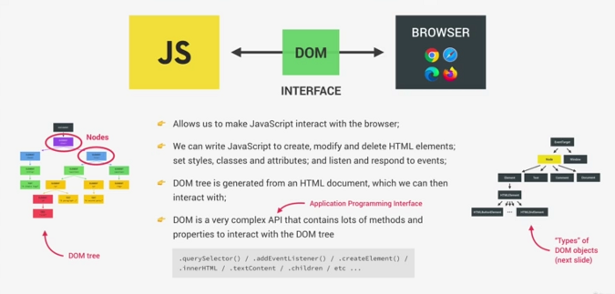

Slide 3
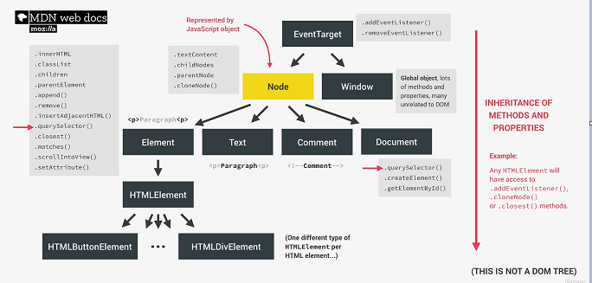

Slide 4
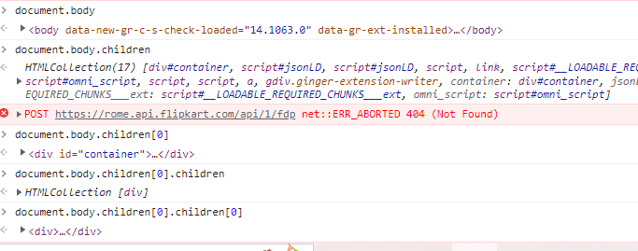
HTML DOM

Slide 5
What we can do using DOM?
Using DOM, JavaScript gets all the power it needs to create/update HTML:
JavaScript can change all the HTML elements in the page
JavaScript can change all the HTML attributes in the page
JavaScript can change all the CSS styles in the page
JavaScript can remove existing HTML elements and attributes
JavaScript can add new HTML elements and attributes
JavaScript can react to all existing HTML events in the page

Slide 6
DOM Methods
HTML DOM methods are actions you can perform (on HTML Elements)
HTML DOM properties are values (of HTML Elements) that you can set or change
<html>
<body>
<p id="demo"></p>
<script>
document.getElementById("demo").innerHTML = "Hello World!";
</script>
</body>
</html>
innerHTML is a property
getElementById is a method

Slide 7
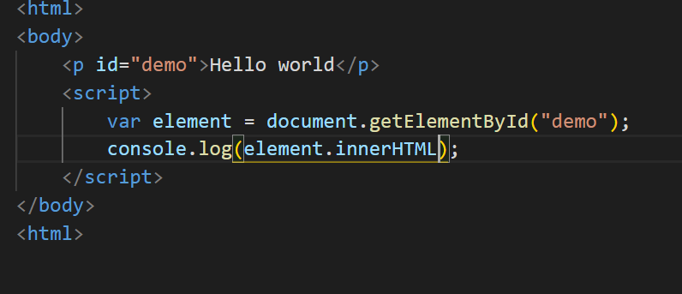
getElementById

Slide 8
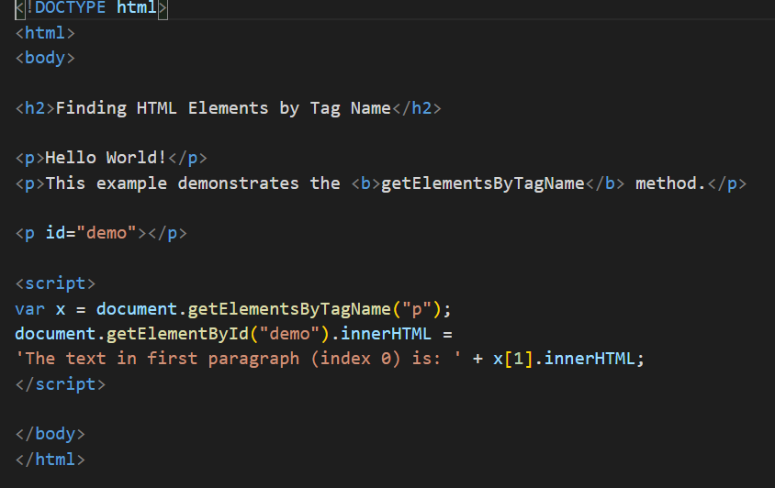
getElementsByTagName

Slide 9
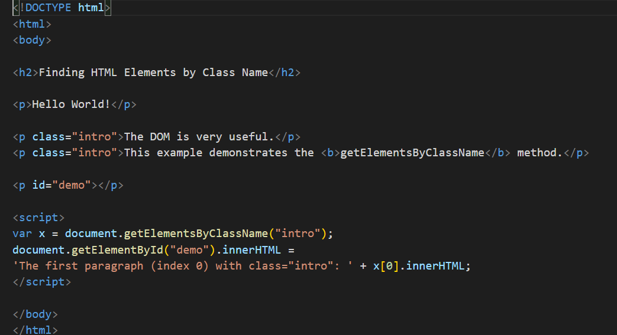
getElementsByClassName

Slide 10
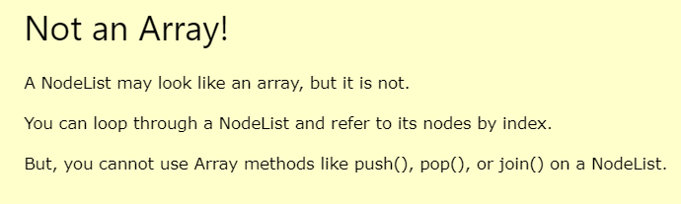
NodeList

Slide 11
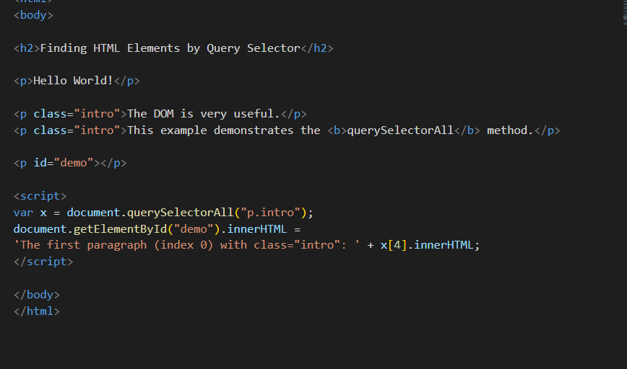
CSS QuerySelector

Slide 12
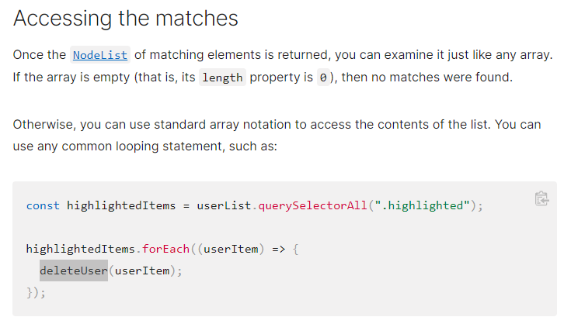
CSS QuerySelector

Slide 13
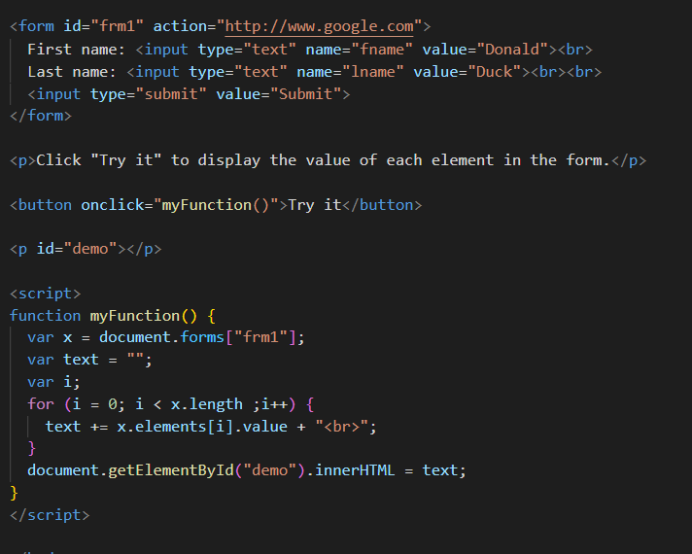
Form Object Collection

Slide 14
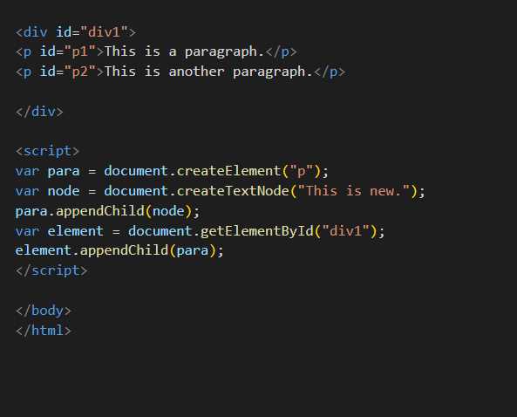
ADD DOM

Slide 15
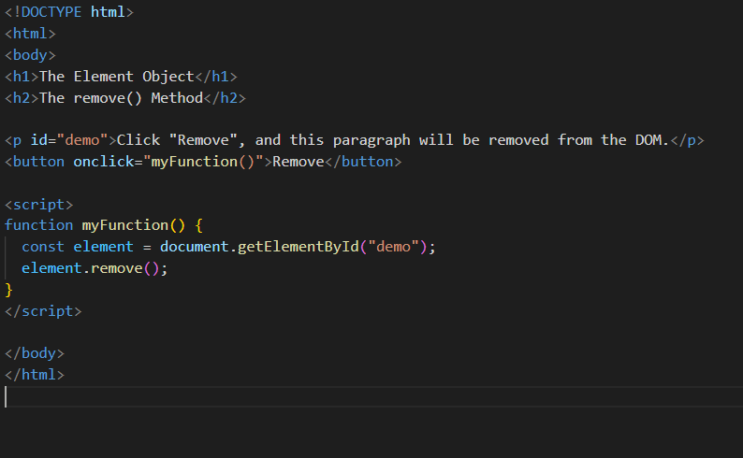
Remove DOM

Slide 16
DOM Methods accessing attributes and styles
getElementById - To change/modify the content of an HTML element
<script>
document.getElementById("p1").innerHTML = "New text!";
</script>
Changing HTML Content
<script>
document.getElementById("myImage").src = "landscape.jpg";
</script>
Changing the Value of an Attribute
<script>
document.getElementById("myP").style.backgroundColor = "red";
</script>
Changing Style property
<script>
document.getElementById("myP").classList.add(“box”); </script>

Slide 17
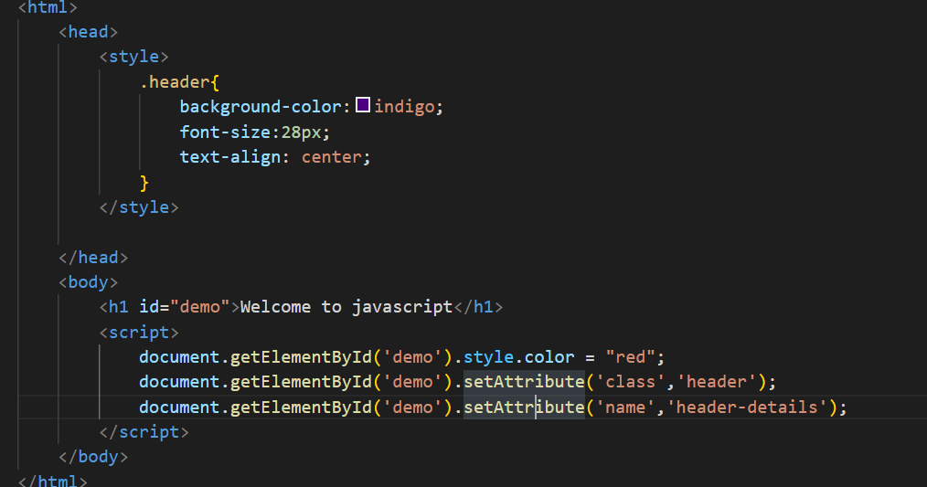
Style and class

Slide 18
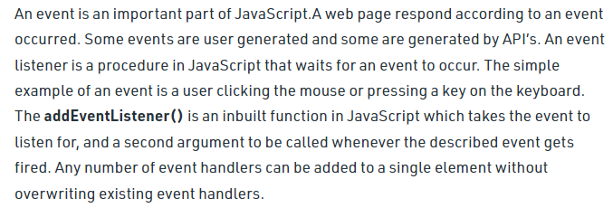
Events

Slide 19
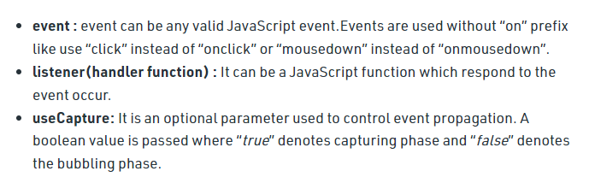
Events

Slide 20
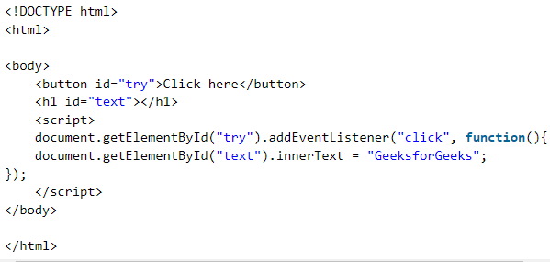
Events

Slide 21
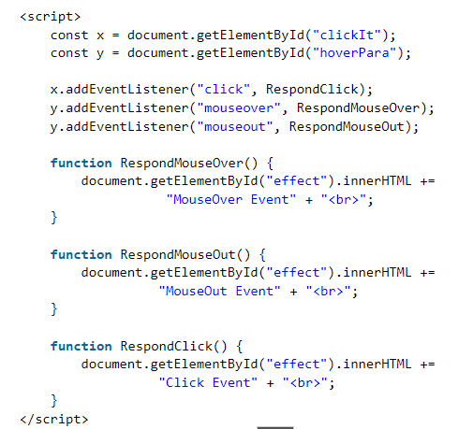
Events

Slide 22
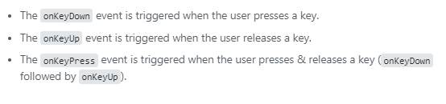
Events

Slide 23
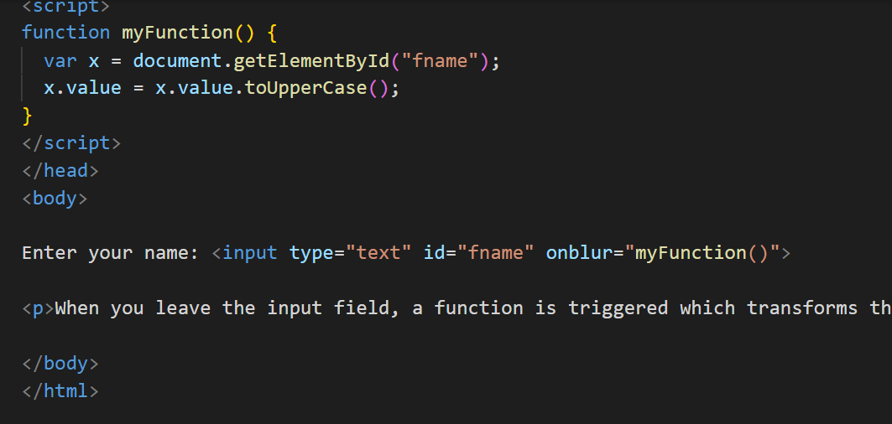
onBlur

Slide 24
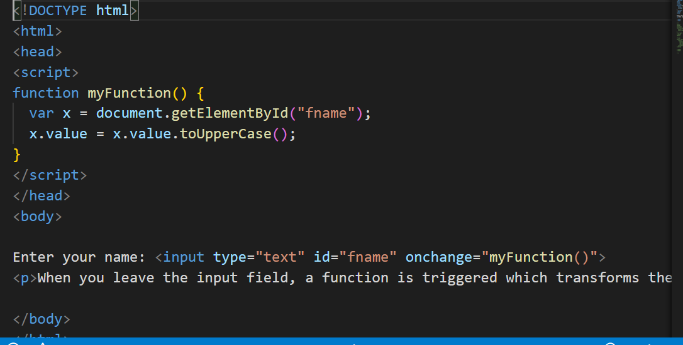
onChange

Slide 25
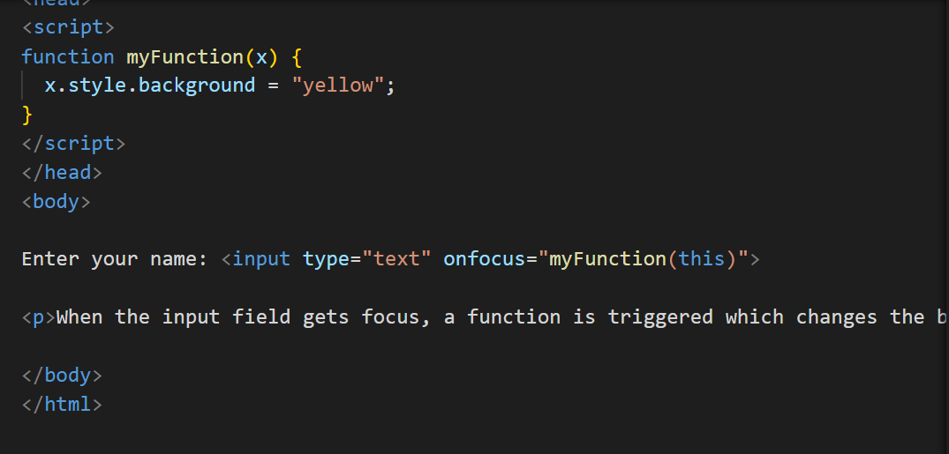
onFocus

Slide 26
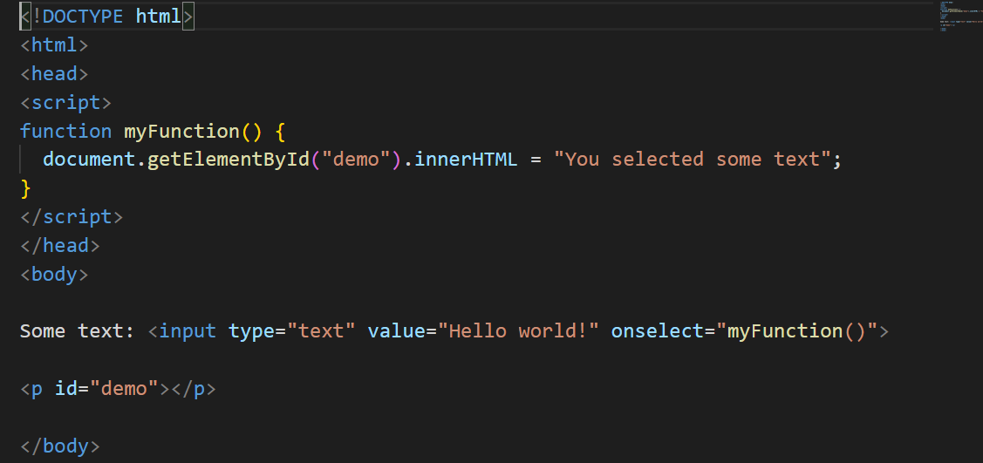
onSelect

Slide 27
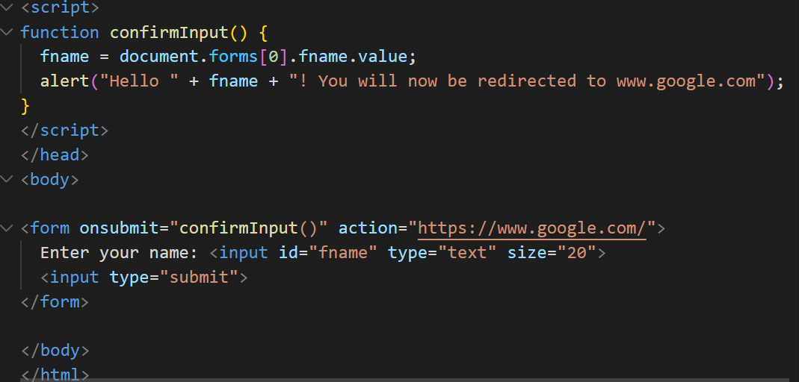
onSubmit

Slide 28
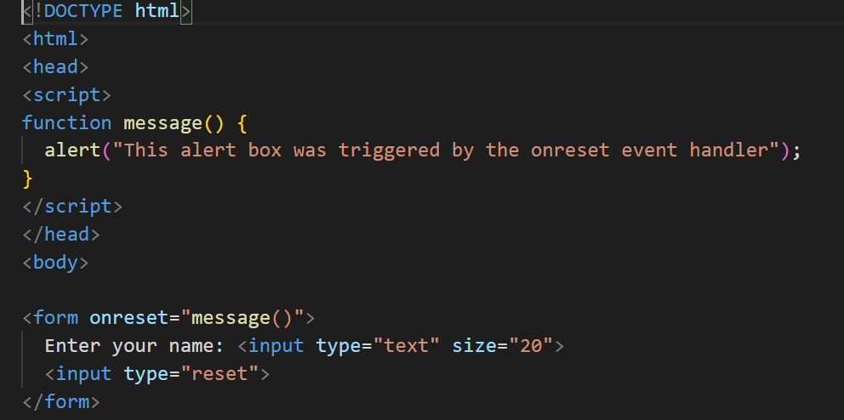
onReset

Slide 29
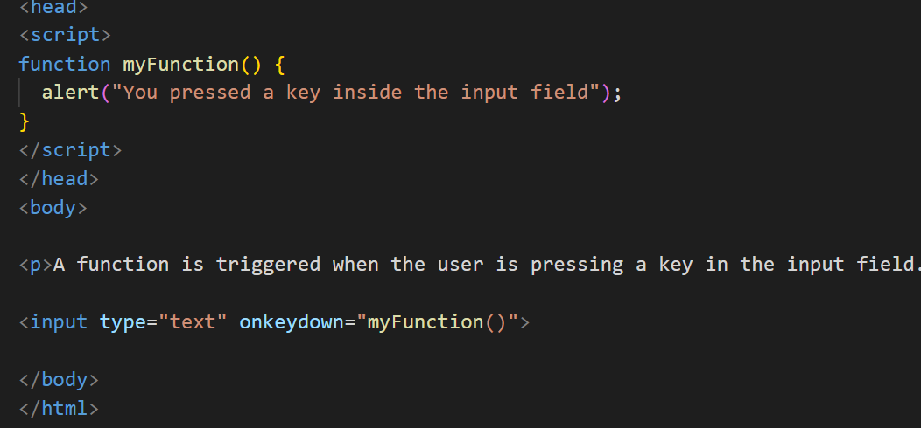
onKeyDown

Slide 30
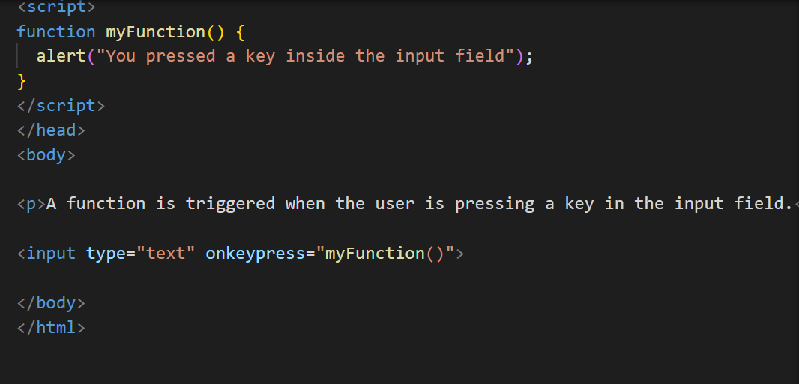
onKeyPress

Slide 31
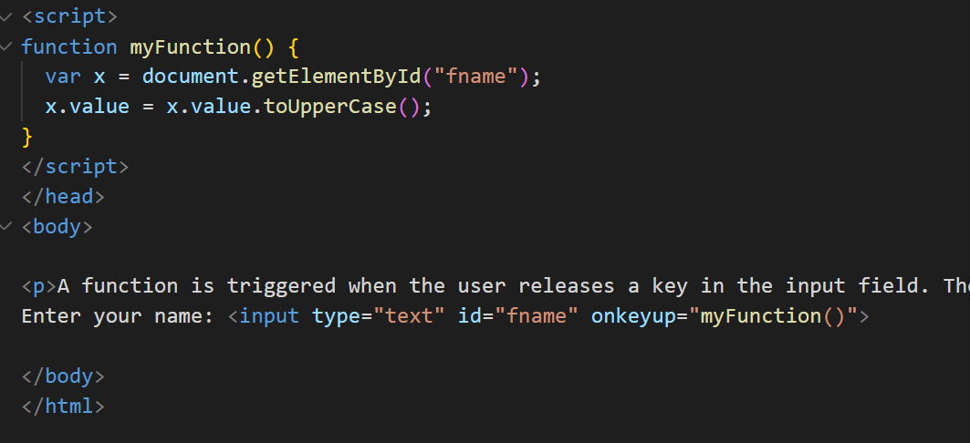
onKeyUp

Slide 32
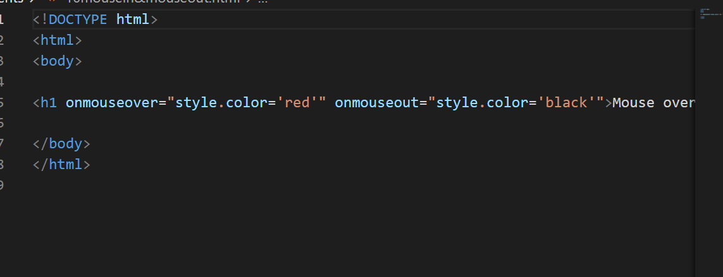
onMouseOver and onMouseOut

Slide 33
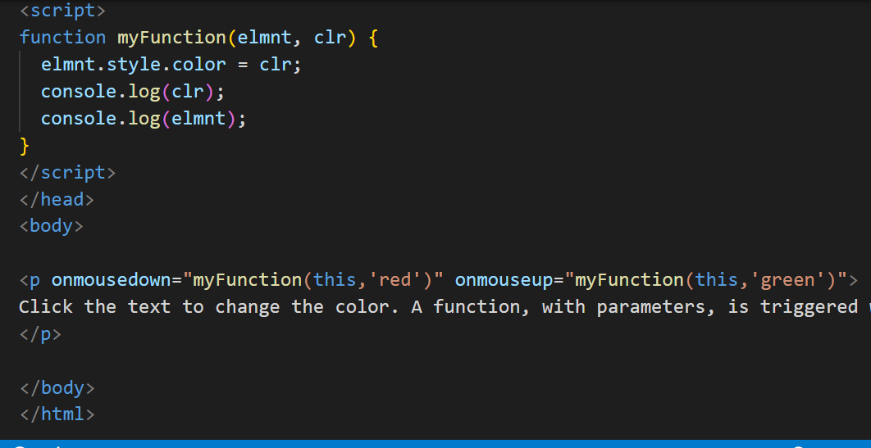
onMouseDown and onMouseUp

Slide 34
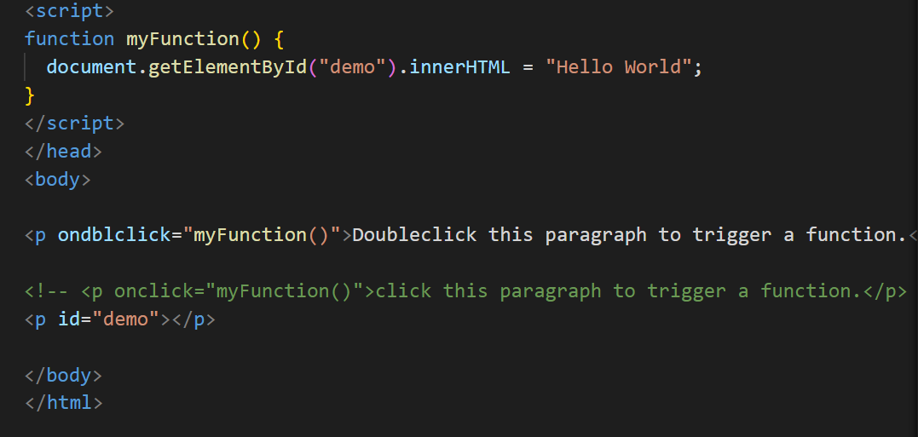
onDoubleClick

Slide 35
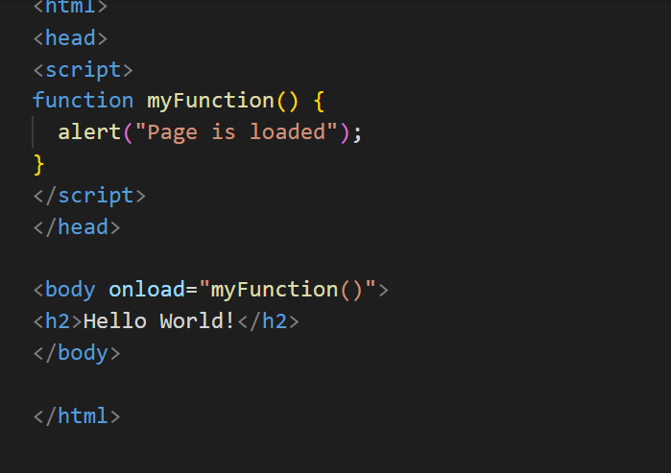
onLoad

Slide 36
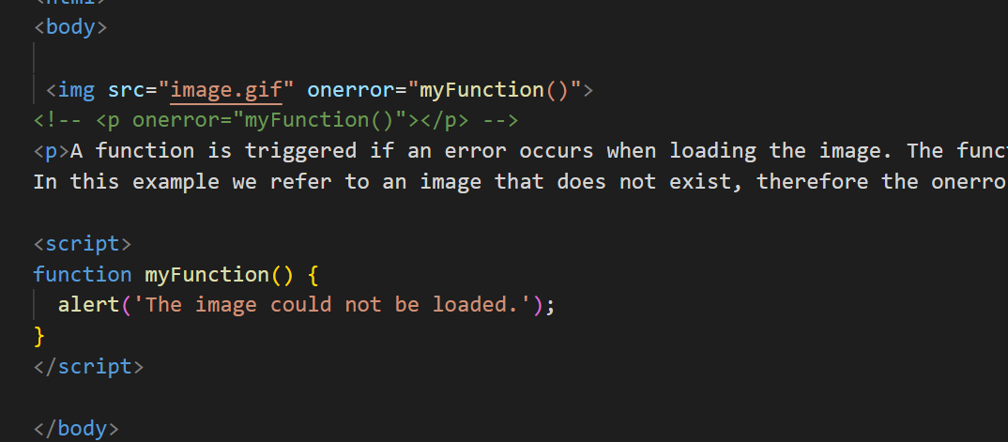
onError

Slide 37
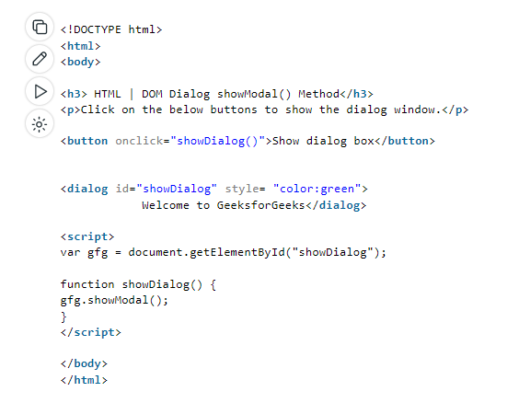
DOM Modal - showModal()

Slide 38
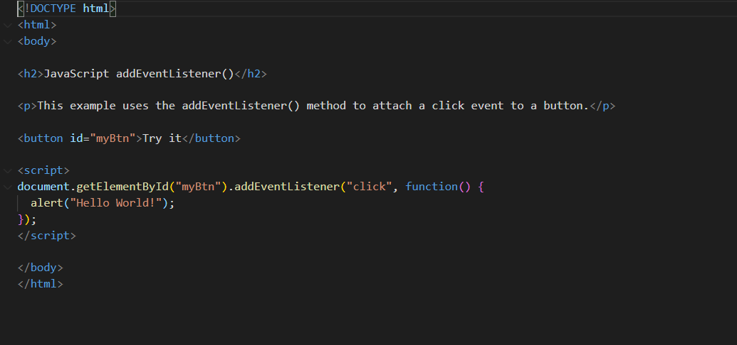
Event Listener

Slide 39
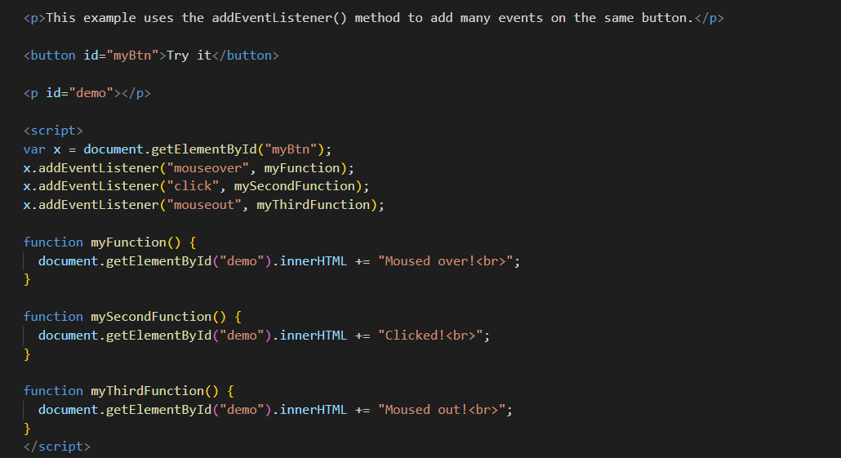
Event Listener

Slide 40
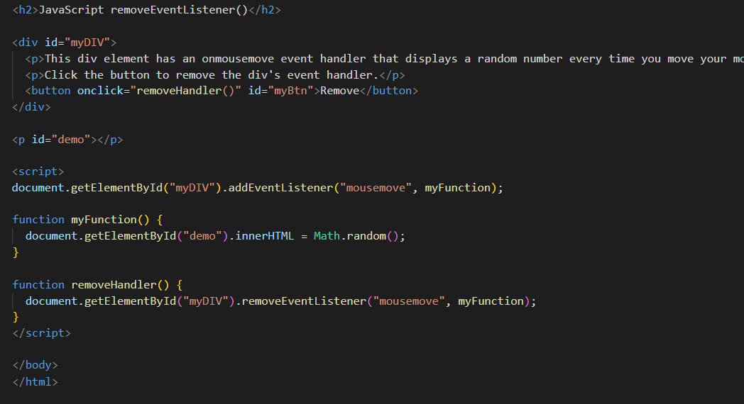
Remove Event Listener

Slide 41
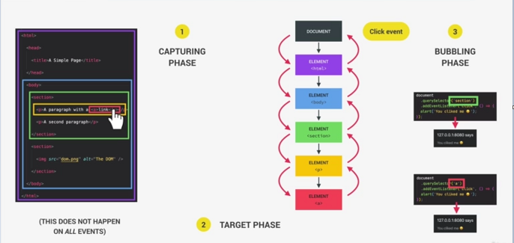
Bubbling and Capturing

Slide 42
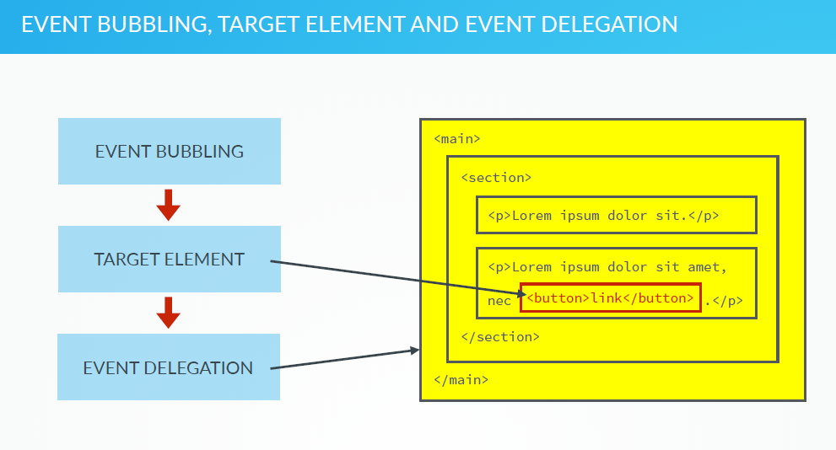

Slide 43
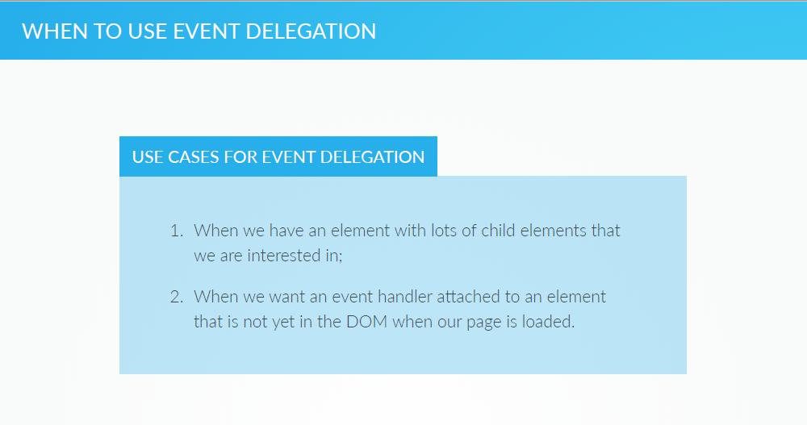

Slide 44
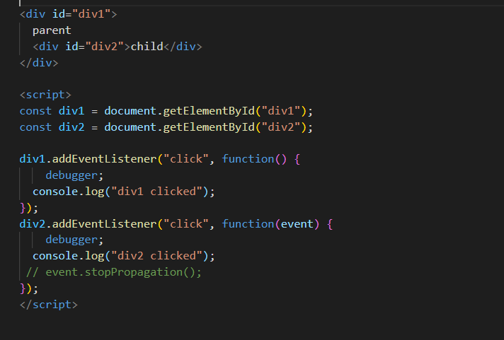
Event Bubbling Example

